Slide 1
Digital Technology
Python – Data Structures

Slide 2
Colab for this part
https://colab.research.google.com/drive/1YsP_O4zihFQvCbDol3f65DUhfzyMgwqE?usp=sharing

Slide 3
TRY, TRY, and TRY! Some advice...
To succeed this part of the course:
You can’t learn programming through ‘osmosis’
It is not rocket science but you need practice
Follow actively the class
At home, put your hands on the class topics and practice!
About ChatGPT

Slide 4
Computer Programming
Computer Programming is the process of writing code in a programming language to instruct how a computer
executes an algorithm successfully to solve a specific problem.
Following steps:
We first need to apply problem solving skills to design an algorithm
We will define the solution clearly and accurately in a programming language.

Slide 5
Algorithm
An Algorithm is (a recipe):
A finite sequence of simple steps
Unambiguous
Well defined
Computer interpretable
Flow of control process that specifies when each step is executed
A condition that specifies when to stop

Slide 6
Python
Python is an interpreted, high-level, general-purpose programming language created in 1991.
Interpreted = instructions are executed directly,
without previously translating the program in machine-language.
High level = strong abstraction from computer details.
General-purpose = designed to write software for the widest variety of application domains

Slide 7
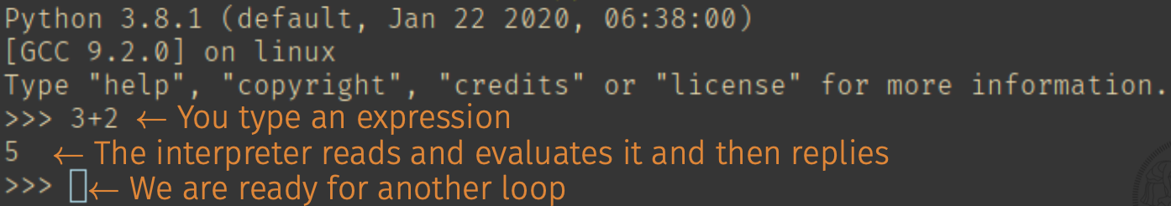
Python REPL
We can use the Python interpreter in two ways: immediate mode and script mode. In the immediate mode, you type an expression and the interpreter immediately shows the result.
This is called REPL, for Read, Evaluate, Print Loop.

Slide 8
Python Scripts
In the script mode, you write a program in a file and use the interpreter
to execute the contents of the file. Such a file is called a script.
Scripts have the advantage that they can be saved to disk, printed, and so on.
A script is just a text file, so you can use whichever editor you prefer to write it.
You can try PyCharm, which is a nice IDE available for GNU/Linux, Windows and Mac.
You will also need to install Python3.
Make sure you are using Python 3 and not Python 2.
https://www.jetbrains.com/pycharm/
https://www.python.org/downloads/

Slide 9
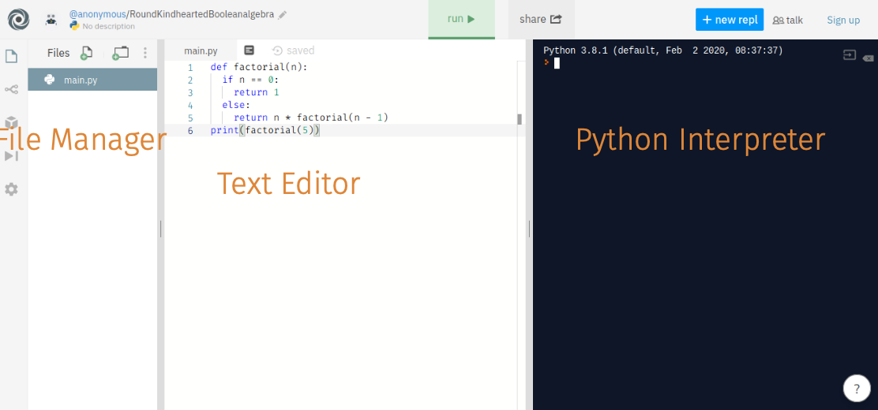
Python Online
If you do not want to install software on your PC, you can use an online environment: https://repl.it.
However, keep in mind that it comes with limited resources.

Slide 10
Python Variables
A program manipulates data objects.
Data objects are stored in variables that correspond to memory cells.
Variables could be of different types.
The variable type defines the operations that could be performed on it.
A variable is created when you first assign a value to it
MEMORY
Memory Cell
Memory Cell
Memory Cell
…

Slide 11
Python Variables Name
The name of a variable:
Can only start with _ (underscore character) or a letter
Can only contains alpha-numeric characters and underscores (A-z, 0-9, _ )
Cannot start with a number
Memory
Edo
edo
EDO
eDo
eDO
Variables name are case sensitive!
Edo, edo, EDO, eDo, eDO, ... are all different variables.
That means each variable is stored in a different memory cell.

Slide 12
Data Types
A program manipulates data objects. Data objects are stored in variables that correspond to memory cells.
Variables could be of different types. The variable type defines the operations that could be performed on it.
Text Type: | str
Numeric Types: | int, float, complex
Sequence Types: | list, tuple, range
Mapping Type: | dict
Set Types: | set, frozenset
Boolean Type: | bool
Binary Types: | bytes, bytearray, memoryview
We are not going to use them
type(object) → return the type of an object

Slide 13
Print
To print any variable into the console, use the print function
my_var = ‘Hello world’!
print(my_var)
my_var = 5
print(my_var)
my_var = 5
print(‘The variable content is:’, my_var)
my_var = 5
print(‘The variable content is {}’.format(my_var))

Slide 14
Input
To collect an input data from the user through the console:
my_var = input(‘please insert a value: ’)
Attention: the input function read the console and produce a str variable.
If you are entering, for example, a float, you have to cast the variable to a float data type.
my_var = input(‘please insert a value: ’)
my_number = float(my_var) # Translate a string to a number
To cast (to transform), a variable of a certain type to another type:
int()
float()
str()
list()
dict()

Slide 15
Text Type
str
my_var = ‘this is a string’
my_var1 = ‘this is a string 1234567890!£$?1^èòà%(){}@#’
My_var2 = “this IS a String”
A string variable, i.e. a sequence of characters, has to be enclosed between or:
Single quotes ‘ ‘
Double quotes “ “

Slide 16
Numeric Types
int: It is a positive or negative number without decimals
my_var = 12
my_var = -12312
float: It is a positive or negative number with decimals. Decimal separator dot ‘.’
my_var = 12.0
my_var = -1543.0
my_var = 12321.2354
my_var = -3.1415
my_var = 3.14e10 # scientific numbers ‘e’ indicates the power of 10 → 3.14 x 10¹⁰
complex:
my_var = 1j
my_var = 5 + 1j

Slide 17
Types to store multiple values
Set
List
Tuple
Dictionary

Slide 18
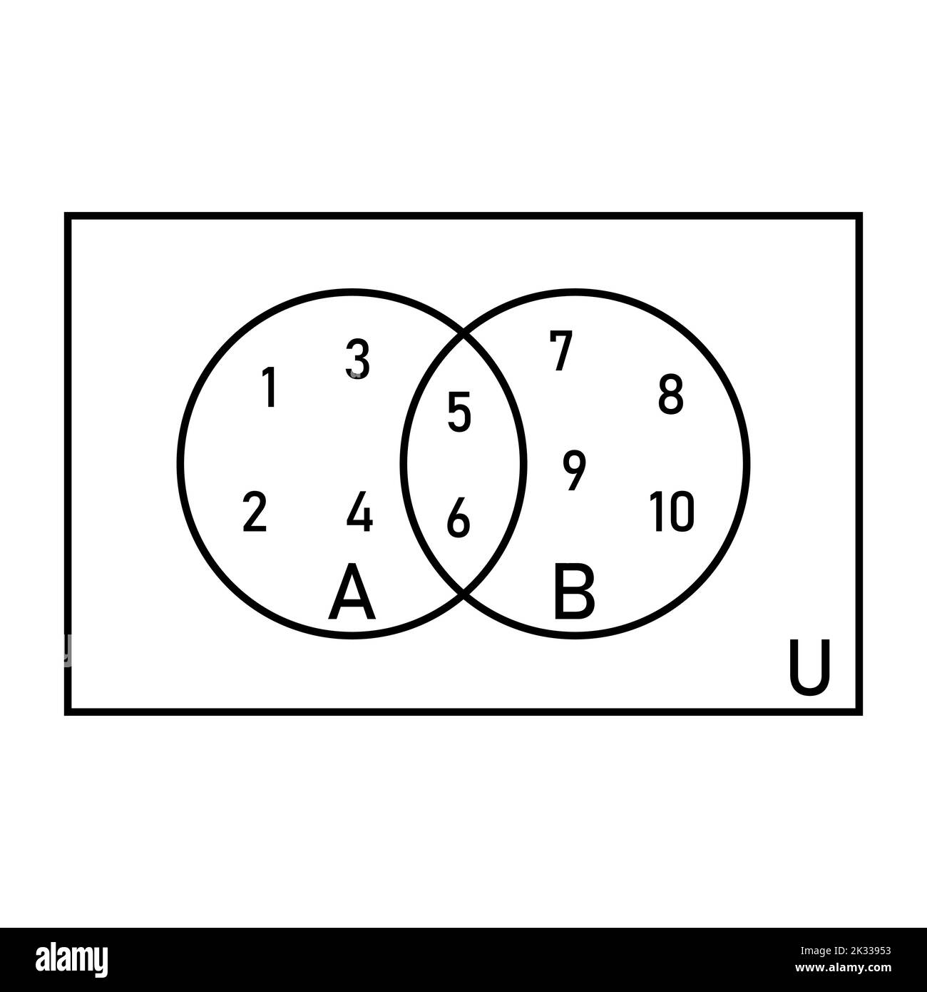
Set Types
Set store multiple values in a single variable.
Sets are unordered, the sets’ items are unchangeable and don’t allow duplicate elements.
my_set = {‘florence’, ‘rome’, ‘milan’}
To add element(s) to a set
my_set.add(‘turin’) # add(item): add item to the set
print(my_ set) # {‘florence’, ‘rome’, ‘milan’, ‘turin’}
tmp_set = {‘naples’, ‘venice’}
my_set.update(tmp_set) # update(item): add items to the set
print(my_ set) # {‘florence’, ‘rome’, ‘milan’, ‘turin’, ‘naples’, ‘venice’}

Slide 19
Set Types
To remove un element from a set
my_set.remove(‘turin’) # remove(item): remove item from the set. Error if not present
print(my_ set) # {‘florence’, ‘rome’, ‘milan’, ‘naples’, ‘venice’}
my_set.discard(‘turin’) # discard(item): remove item from the set. If not present it’s ok
print(my_ set) # {‘florence’, ‘rome’, ‘milan’, ‘naples’, ‘venice’}
Union. From two sets, create a new set with all the items from both sets.
my_set1 = {‘red’, ‘green’, ‘yellow’}
my_set2 = {‘pink’, ‘blue’}
my_set3 = my_set1.union(my_set2) # it is the same of my_set2.union(my_set1)

Slide 20
Set Types
Other methods of Set type:
A.intersection(B) → return a set that is the element intersection of A and B
A.difference(B) → return a set that is the set difference of A and B

Slide 21
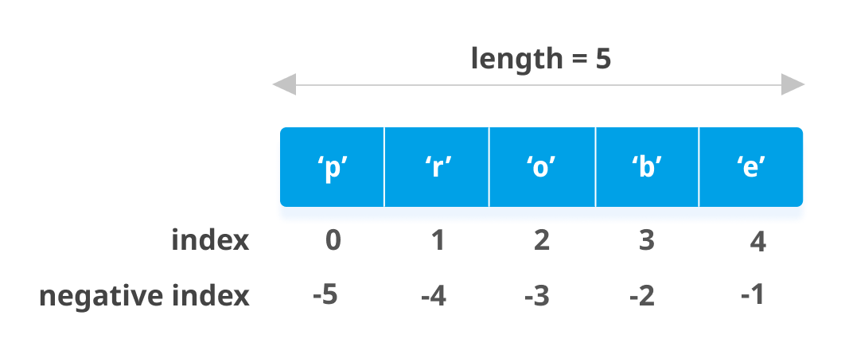
Sequence Types: List
Lists are used to store multiple values in a single variable.
List elements are defined between square brackets
my_list = [1, 2, 3, 4, 5]
The element of a list can be of different data types:
my_list = [1, 3.1415, ‘this is a string’, [1, 2, 3, 4]]
Lists are Ordered. You can access the single element (item) of the data type with an index.
Lists allow duplicates.
my_list = [1, 1, 1, 1]
To know the number of item, or the length of a list:
print(len(my_list)) # 4

Slide 22
Sequence Types: List
Lists are Changeable. You can add, remove or change elements of the data type after it is created.
my_list = [11, 22, 33, 44, 55]
my_list.append(66) # append(value): add, append, a value to the end of the list
my_list.insert(0,0) # insert(index, value): add, append, a value to the index-th list’s item
print(my_list) # [0, 11, 22, 33, 44, 55, 66]
my_list.pop(2) # pop(index): remove the index-th item from the list and get its value back
print(my_list) # [0, 11, 33, 44, 55, 66]
my_list.remove(33) # remove(value): remove the first item with value ‘value’ from the list
print(my_list) # [0, 11, 44, 55, 66]
del my_list[0] # del list[index]: remove the index-th item
my_list.clear() # clear(): delete all the elements from the list
print(my_list) # []

Slide 23
Sequence Types: List
Indexes start from 0. To acces the i-th element of the list my_list[ i ]
my_list = [1, 2, 3, 4, 5]
print(my_list[0]) # 1
my_list[0] = 100
print(my_list[0]) # 100
print(my_list[-1]) # 5
print(my_list[-2]) # 4
print(my_list[1:3]) # [2, 3]. [start_index: end_index] return a sub-list
# from the item with index start_index to the item in position # end_index -1

Slide 24
Sequence Types: Tuple
Tuples are used to store multiple values in a single variable.
List elements are defined between round brackets
my_tuple = (1, 2, 3, 4, 5)
The element of a list can be of different data types:
my_ tuple = (1, 3.1415, ‘this is a string’, [1, 2, 3, 4])
Tuples are ordered and indexed. You can access tuple elements like in lists.
print( my_tuple[0] ) # print 1
print( my_tuple[3] ) # print [1, 2, 3, 4]
Tuples are immutable
my_tuple[0] = 100 # Not legal. It this a ‘typeError’. Your program crashes.

Slide 25
Sequence Types: Range
Range data types are create with the range function
The function signature is: range(start, stop, step)
The default value for start is 0. The default value for step is 1.
print(list(range(0, 6))) # [0, 1, 2, 3, 4, 5]
print(list(range(1, 6))) # [1, 2, 3, 4, 5]
print(list(range(6))) # [0, 1, 2, 3, 4, 5]
print(list(range(0, 6, 2))) # [0, 2, 4]

Slide 26
Mapping Types: Dictionaries
Dictionaries store values in key : value pairs. The value could be of any data type.
Dictionaries are ordered, changeable and don’t allow duplicate elements.
my_dict = {‘italy’: ‘euro’, ‘US’: ‘dollar’, ‘france’: ‘euro’, ‘brazil’: ‘real’}
To access the element of a dictionary, you should use the keys
print(my_dict[‘italy’]) # ‘euro’
print(my_dict.get(‘US’)) # ‘dollar’
To update an item of the dictionary
my_dict[‘US’] = ‘US dollar’ # changing the value of a key in the dictionary
my_dict.update({‘US’: ‘’US dollar $}) # changing the value of a key in the dictionary

Slide 27
Mapping Types: Dictionaries
To add an element (a pair of key:value) to a dictionary
my_dict[‘spain’] = ‘euro’ # add a new pair key:value into the dictionary
my_dict.update({‘spain’: ‘euro’}) # add a new pair key:value into the dictionary
To delete a key from a dictionary (as in List clear() method delete all the items)
del my_dict[‘spain’] # delete the key ‘spain’ and its value
my_dict.pop(‘brazil’) # delete item ‘brazil’ and its value. Also returns the key’s value
print(my_dict) # {‘italy’: ‘euro’, ‘US’: ‘US dollar $’, ‘france’: ‘euro’}
To know the number of items in a dictionary:
print(len(my_dict)) # 3

Slide 28
Boolean Types
A Boolean type ‘bool’ can only have two values:
True
False
The function bool(object) evaluate the object and return True or False.
Any string is True, except empty strings .
Any number is True, except 0.
Any list, tuple, set, and dictionary are True, except empty ones.
See the python file of the lesson for examples and further details

Slide 29
Python Operators
An operator performs an operations on value and variables
Arithmetic operators
Assignment operators
Comparison operators
Logical operators
Membership operators

Slide 30
Arithmetic operators
Addition: +
Subtraction: -
Multiplication: *
Division: /
Modulus: %
Exponentiation: **
Floor division: //
See the python file of the lesson for examples and further details

Slide 31
Assignment operators
= x=5 → Assign the value 5 to variable x
+= x+=5 → x=x+5
-= x-=5 → x=x-5
*= x*=5 → x=x*5
/= x/=5 → x=x/5. Division
%= x%=5 → x=x%5 Modulus
**= x**=5 → x=x**5
//= x//=5 → x=x//5 Floor
See the python file of the lesson for examples and further details

Slide 32
Comparison operators
Compares two data objects
Equal: ==
Not Equal: !=
Greater than: >
Less than: >
Greater than or equal: >=
Less than or equal to: <=
See the python file of the lesson for examples and further details

Slide 33
Logical operators
Compare conditional statements a return a bool object:
A and B: It is True if both A and B are True, otherwise is False
A or B: It is True if either A or B is True, otherwise is False
not A: True if A is False, False if A is True
See the python file of the lesson for examples and further details

Slide 34
Membership operators
To test if an object is present in a data Type
in: return True if the object is present in the data type
not in: return True if the object is not present in the data type
See the python file of the lesson for examples and further details

Slide 35
Additional material
A primer on Python data structures
https://docs.python.org/3/tutorial/datastructures.html
Python tutorial and exercises
https://www.w3schools.com/python/default.asp

